Slide 1
Team Five Research

Slide 2
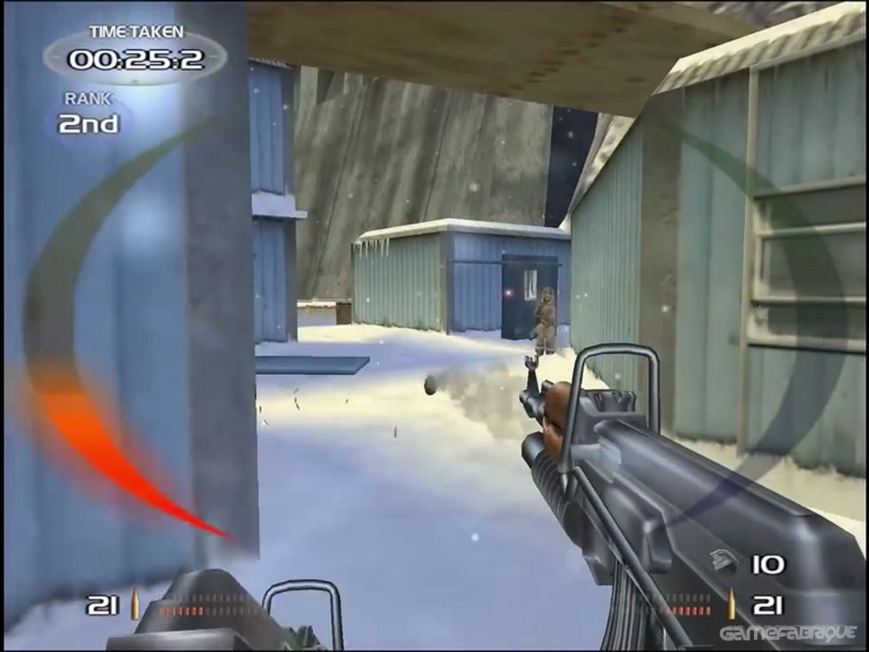
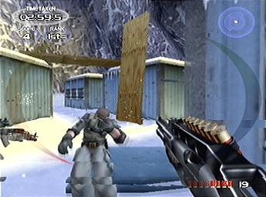
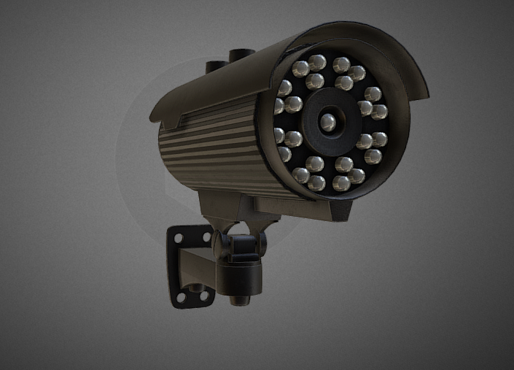
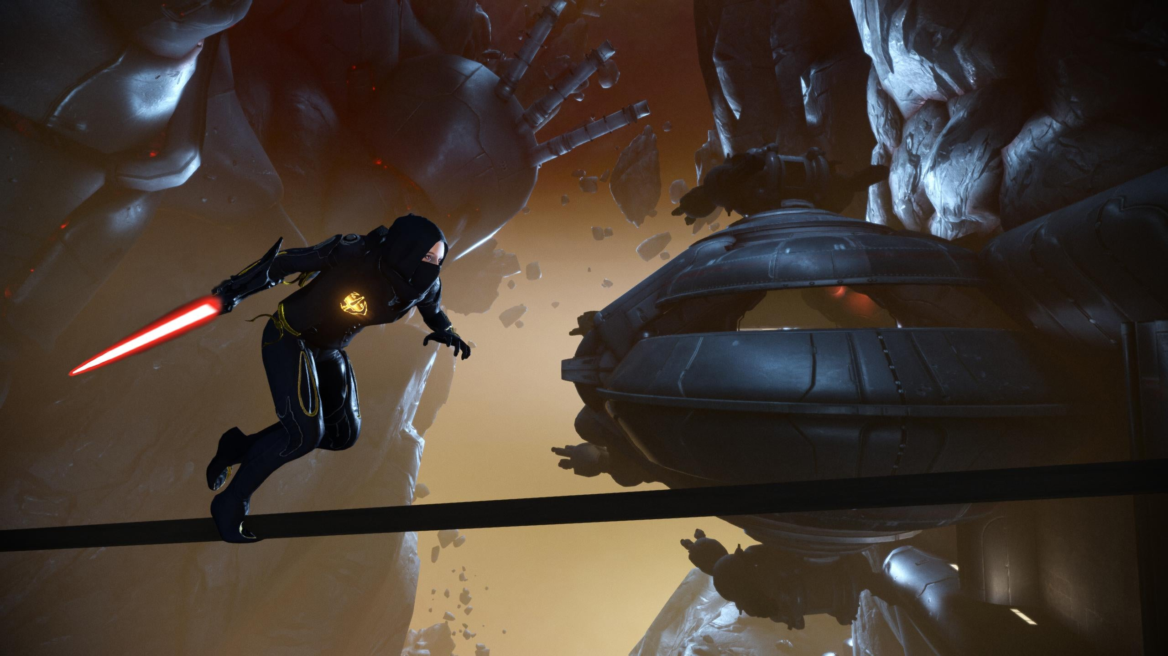
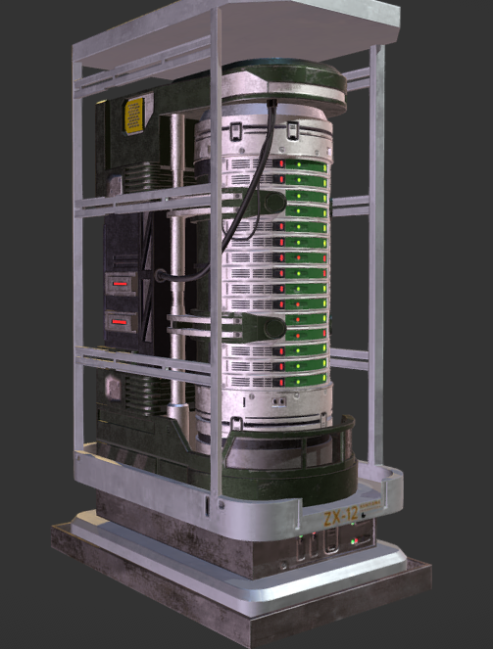
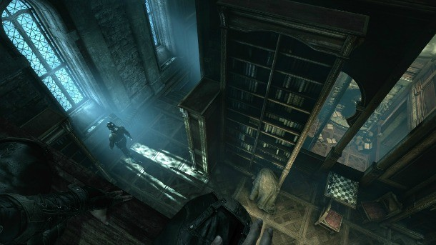
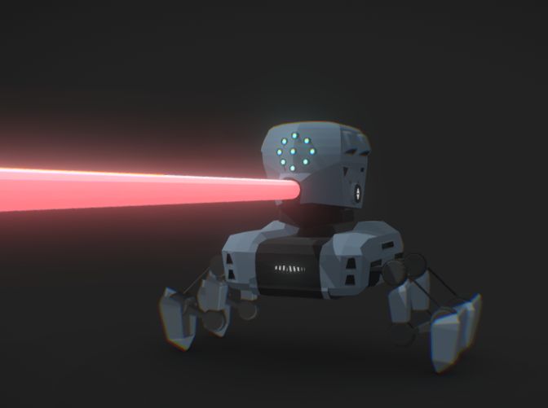
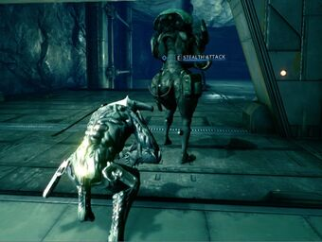
Inspiration: Moodboard

Slide 3
Possible Mechanics
Mechanics from Other Games:
Detection (Warframe) Area of Detection/Alarm System (button hold)
Metal Gear Solid
Payday 2
Tasks (Among Us)
Marked Status (Kenshi)
GTA Star System
Masquerade Breach (Vampire the Masquerade: Bloodlines)
Possible movements:
Crawling
Climbing
Platforming timing (Mirror edge inspo)

Slide 4
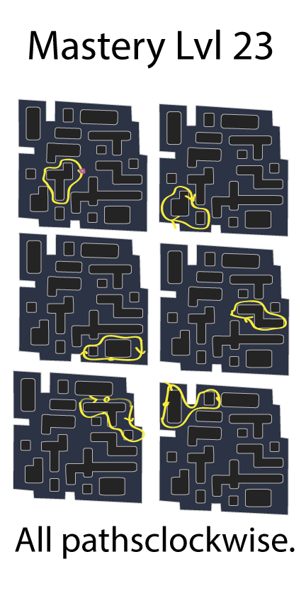
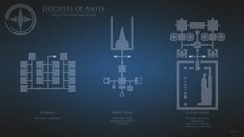
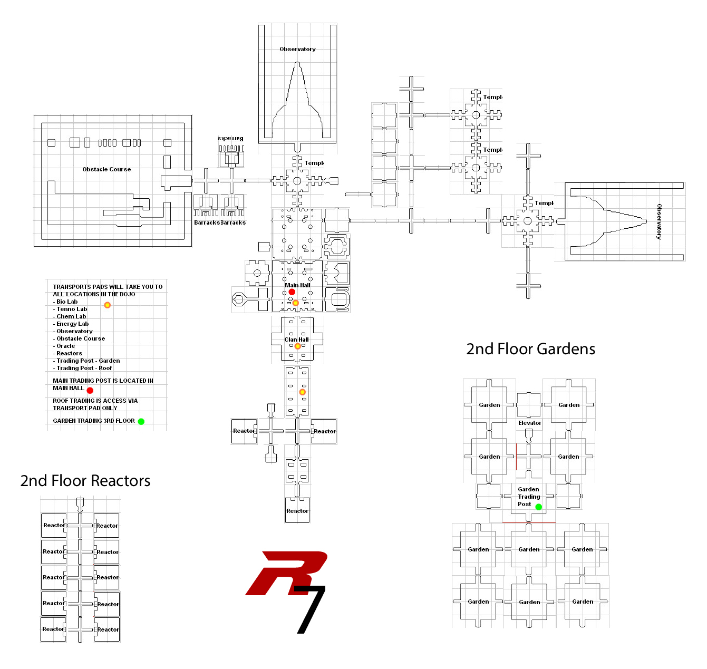
Possible Map Inspirations
Warframe – Timesplitters
Possible Additions:
Cameras
Lasers
Alarm triggers
Silenced pistol? Bow?
Laser bots
Extraction point
Data shelf (Reference: Minority Report [Tom Cruise Movie])
Slippery floors
Stealth detection system
Stealth animation
Sight detection meter

Slide 5
Developed Map: I ‘Orange’

Slide 6
Developed Map: II ‘Cuboid’

